Slide 1

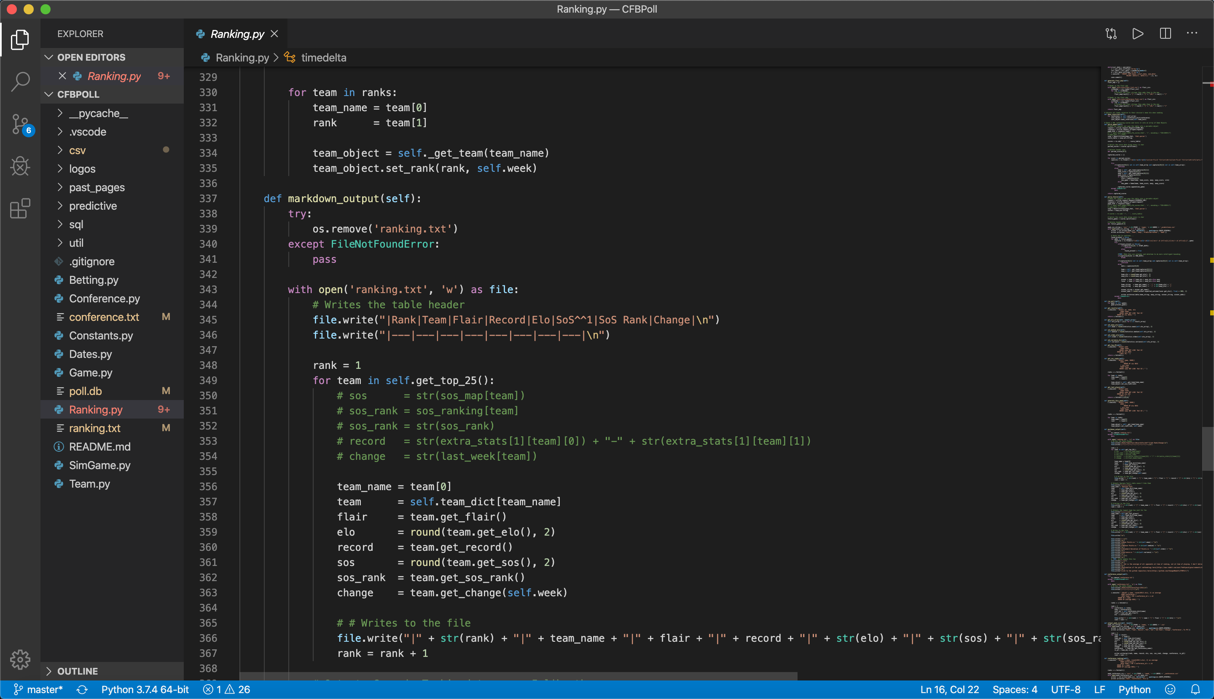
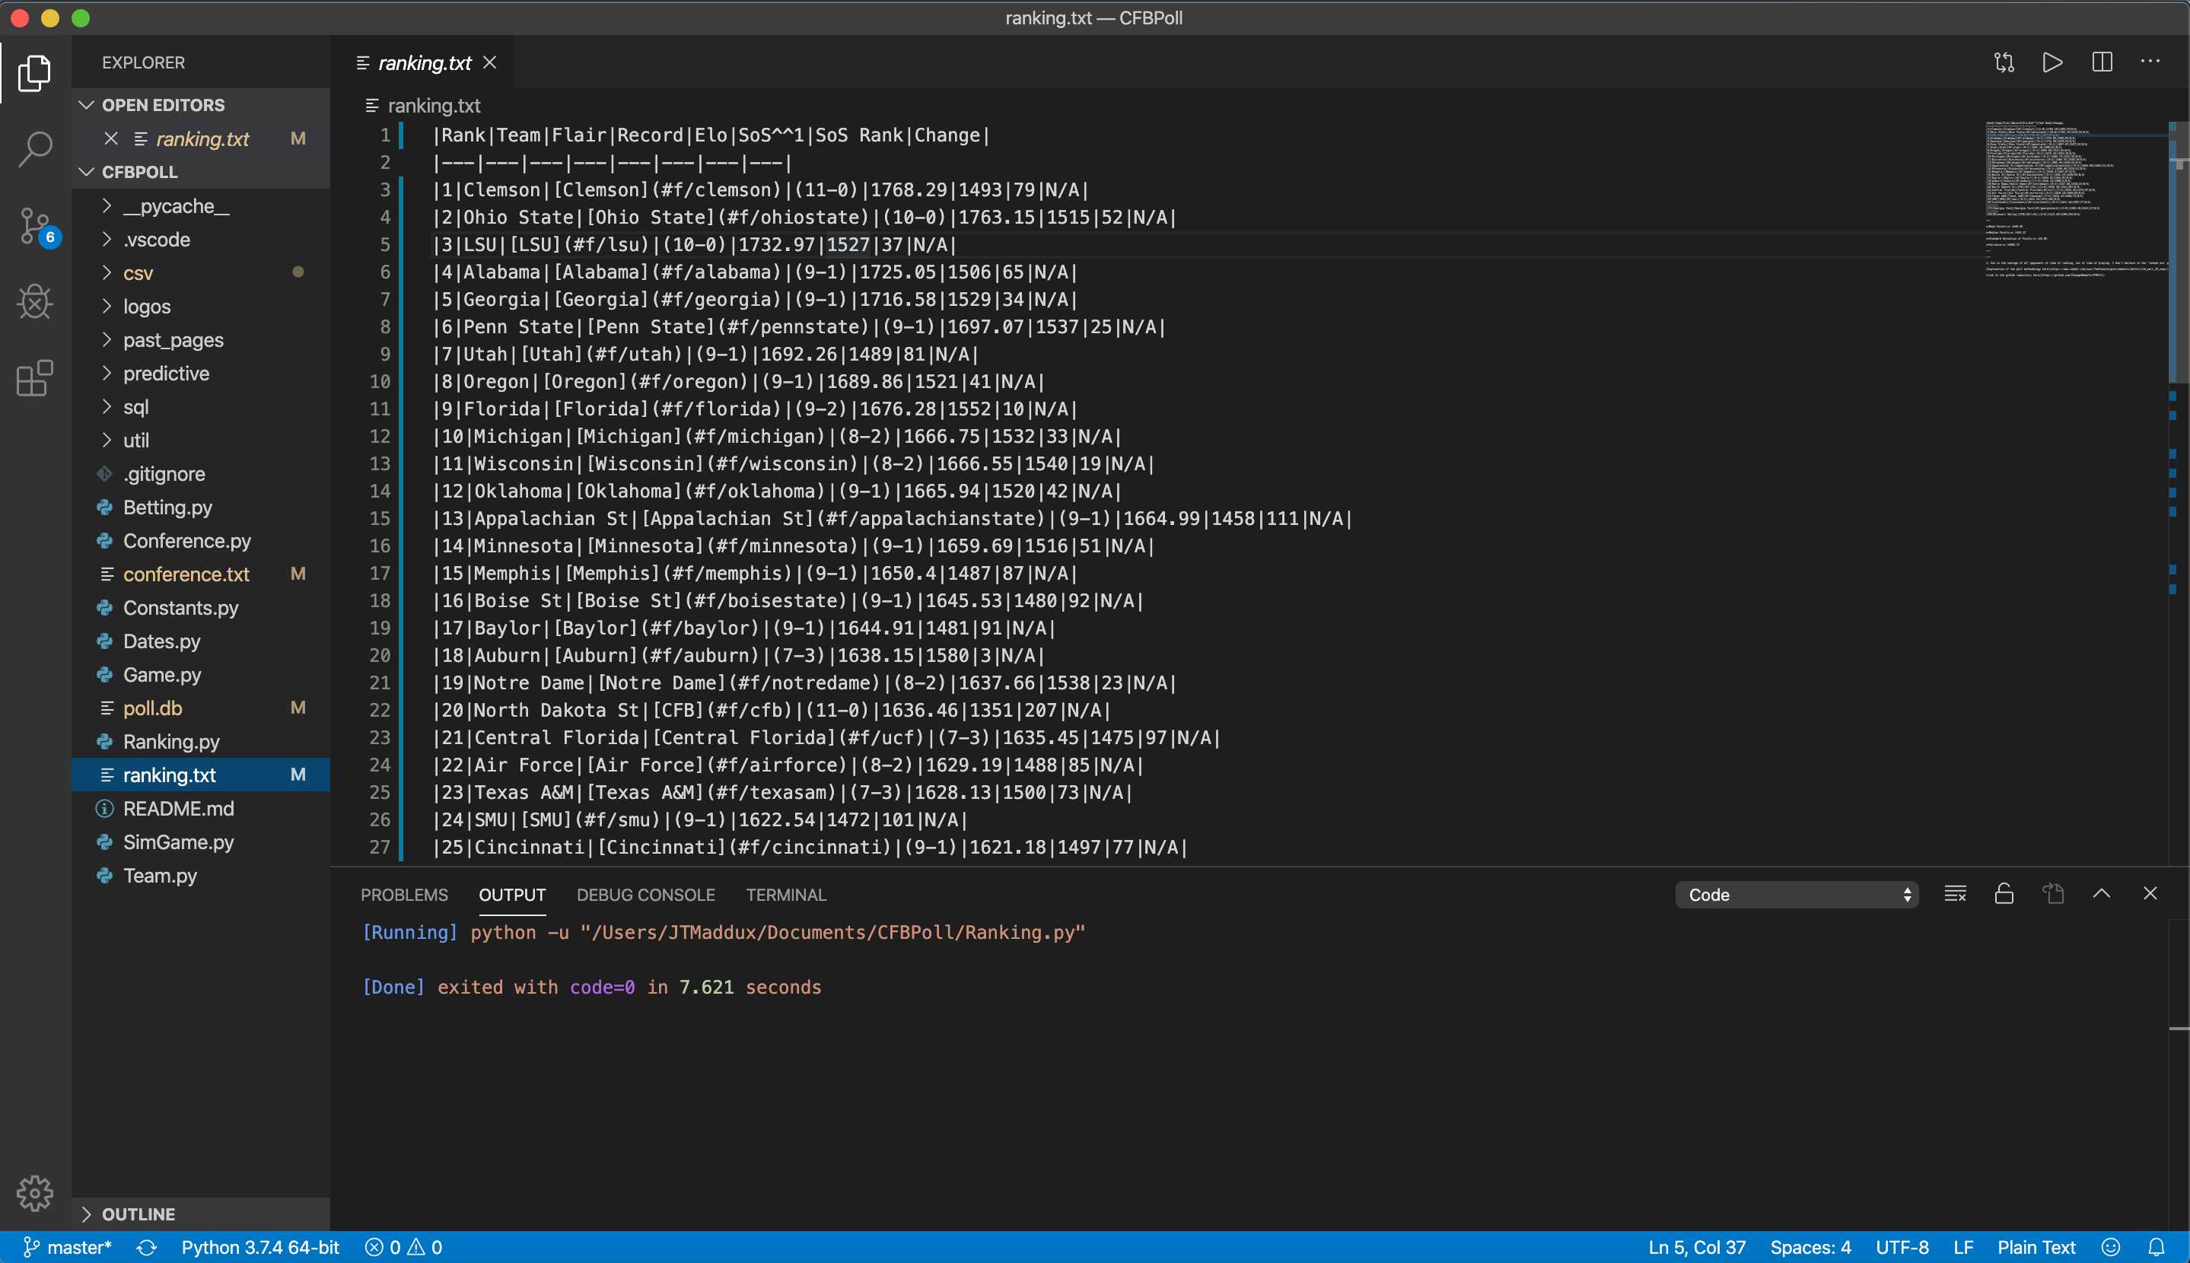
NCAA Football Rankings
Team Members: JT Maddux & Jacob Burdette
GitHub Repository: https://github.com/ksu-is/Football-Rankings
This program will scrape the top NCAA football teams statistics and will create a document with the top ranked teams in order.

